Slide 1
Tips for Optimizing your MPiec Application Program
Part 1:
Memory Allocation & Optimization
Task Timing Analysis
Function Block Error Interlocking
Hosted by:
Kevin Hull
Nishant Unnikrishnan
Notes:
Name:
Company:
Address:
Phone:

Slide 2
Agenda
Tips for Understanding and Managing Controller Memory
Total System Memory
Global Variables
Compiled POU Code
POU sizes
Cam Memory
Maximizing Program Performance & Robustness
HIRES_TASK_TIMING_INFO_ARRAY
Increase Troubleshooting Effectiveness with ErrorID

Slide 3
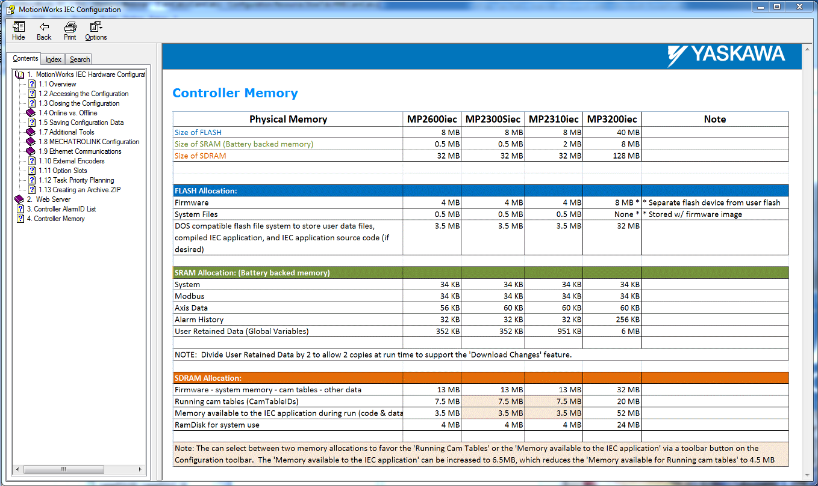
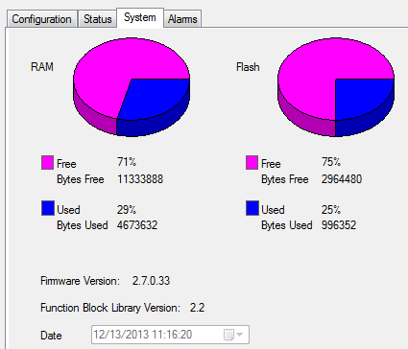
Memory Allocation
Out of the box MP2300Siec
(Memory available to user)
11,333,888
2,964,480
The actual memory available to the IEC application is cut by half. This allows the controller to do “Download Changes” and swap the project and data on the fly.

Slide 4
Good Questions….
Camming
Q1) Is there a limit to how many points we can put in one of our Cam tables?
Q2) What is the memory size where we would store the cam tables?
Q3) Are Cam tables stored in RAM or Flash or either (maybe RAM if marked retained)?

Slide 5
Camming

Slide 6
Cam Memory Q & A
Camming
Q1: What is the data type of the .csv, I think LReal. If so, that is a lot more bytes per point ( A long real, is that 8 bytes per point ? )
A1: The data in the CSV is ASCII, not binary.
This means that a master / slave pair like 12.456678,67.21344323 occupies 21 bytes (the character count plus a carriage return for a total of 22 bytes.
A CSV file may or may not be larger than binary depending on how many actual characters of precision are required.
On the FLASH side, (what you see in the project archive) is a CSV.
CSVs are loaded into the motion engine (using Y_CamFileSelect) and converted to binary in the SDRAM.

Slide 7
Cam Memory Q & A
Camming
Q2: Are the master points pre-defined in equal increments?
A2:The master / slave data does not need to be equal increments
This can save memory if the required motion has a period with a simple relationship. (Straight Line)
Q3: For a 1,000 point cam, will there be 2,000 total points (1,000 master and 1,000 slave) ?
A3: Every slave requires a master and slave data value.
Together, each Master / Slave value is a “cam point.”

Slide 8
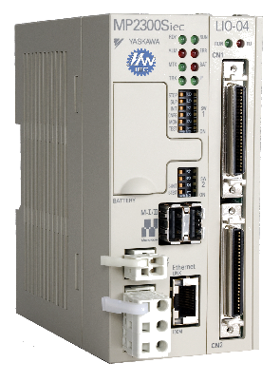
Large Program Specs
(68) CamSegmentStruct
12,868 bytes each
875,024 bytes total
21 “Large” POUs
Nearly 64 Kbytes of compiled code each
1,260,000 bytes
(24) CSV cam files in flash
ASCII master slave values
2,137 data points in each
77,436 bytes in each file
1,858,464 bytes in flash
(4) Cyclic Tasks
(16) Servo Axes
4 mSec Mechatrolink

Slide 9
Cam Memory Q & A
Camming
Q4: With Y_CamIn, how many points can I generate?
A4: This is not a simple answer, the answer depends on several factors, such as number of cam tables, size of application program, and more.
But… I would imagine you could make a cam file with 32768 points.
As a CSV, lets estimate the size to be 22 bytes * 32768. This would be about 721K. Its possible three or four cams this size can be loaded in the FLASH at once. That would be almost 3 MB.
When one of these cams is copied to the SDRAM for use by the Motion Engine using Y_CamFileSelect, it would occupy (8 + 8) * 32768, or 524,288 bytes. You really only need one or maybe two per axis in the Motion Engine (SDRAM) at once. You can always delete them (using Y_ReleaseCamTable) and reload when necessary.

Slide 10
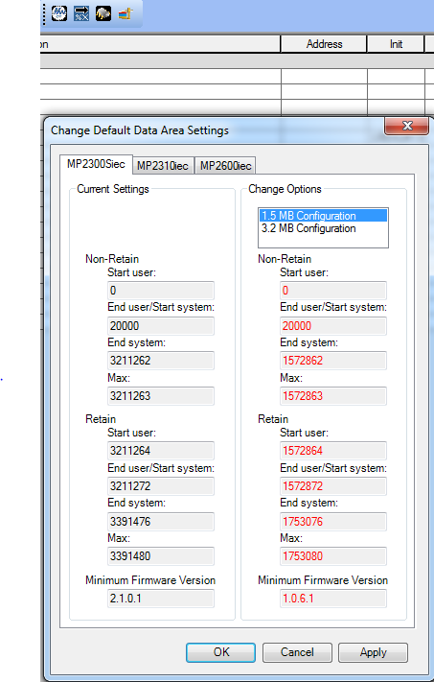
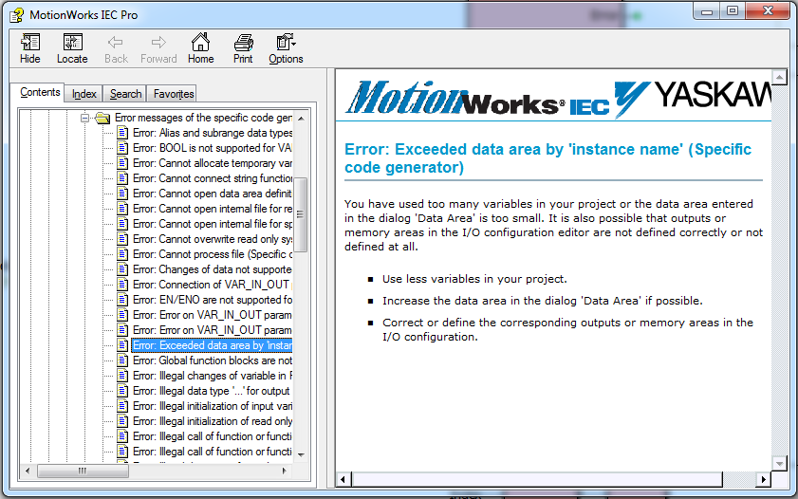
Error: Exceeded the Data Area
SDRAM Allocation: Possible Issues
What does it mean?
The memory required for the IEC application is too large for the space allocated in SDRAM.

Slide 11
SDRAM Allocation: Possible Issues

Slide 12
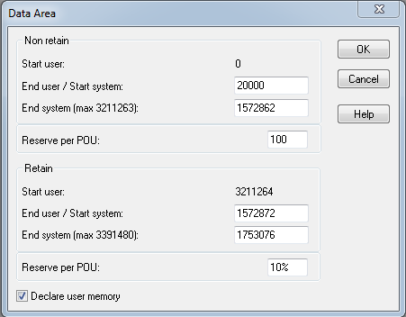
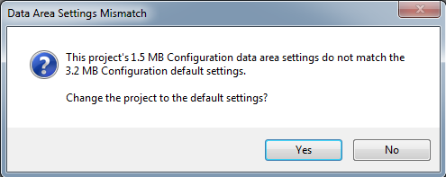
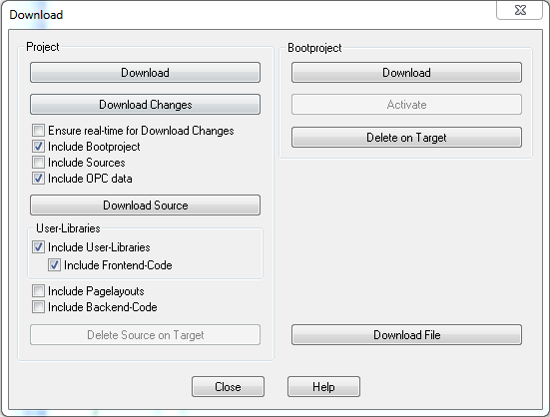
IEC variable memory allocation
SDRAM Allocation: Possible Issues
If the memory allocation is set to 3.2 MB, you will get this message when starting a new project or opening an existing project which is configured for 1.6 MB allocation
If the memory allocation is set to 3.2 MB, you will get this message when starting a new project or opening an existing project which is configured for 1.6 MB allocation
These Errors basically mean that memory configuration settings between MotionWorks IEC and your project are out of sync

Slide 13
IEC variable memory allocation
SDRAM Allocation: Possible Issues
You may have too many large variables (Data Types) defined but never used.
Remove unused variables
Recycle large variables where possible
Variables of type Y_MS_CAM_STRUCT can be recycled!

Slide 14
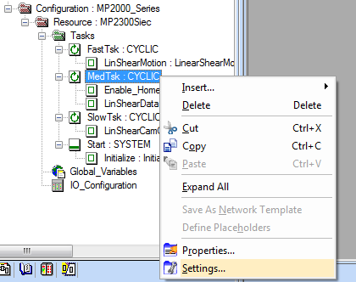
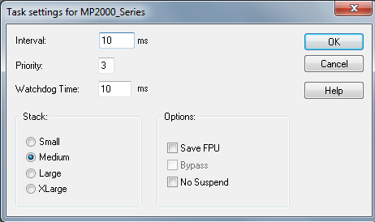
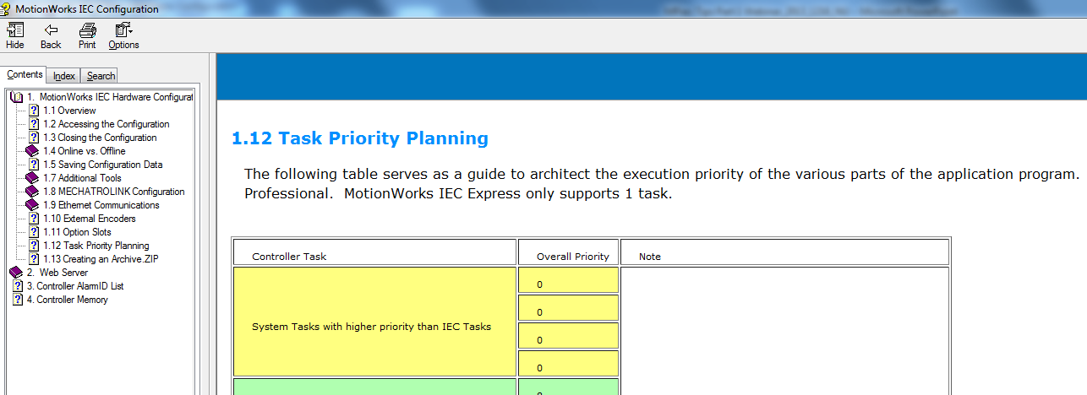
Task Timing in MPiec Controllers
IEC Application task priority: 0 - 16
Set Watchdog Time = Interval
Detailed help on task priorities in section 1.12 of Hardware Configuration help

Slide 15
Task Timing in MPiec Controllers
Slow task
Medium task
Outputs written*
Fast task (FT)
Inputs read*
MLINK task
MECHATROLINK
Startup
FT Start
FT end
Fast
Priority 0
Medium
Priority 7
Medium task start
Medium task end
Slow
Priority 15
Slow task start
Slow task end
Default
Default task start
* If IO is assigned to medium task

Slide 16
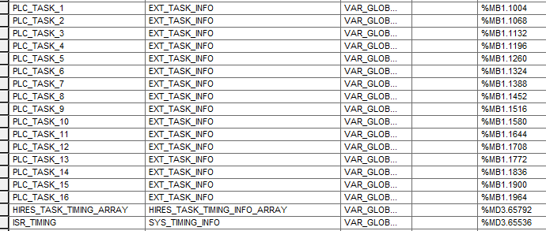
Task Timing Monitoring Variables
ProconOS Controllers: MP2300Siec and MP2310iec
Structures for real time task timing information available in the global variable table in MotionWorksIEC 2.5
Variable name
DATA TYPE
ADDRESS
Task timing in ms
Task Timing in us
MECHATROLINK II Timing in us

Slide 17
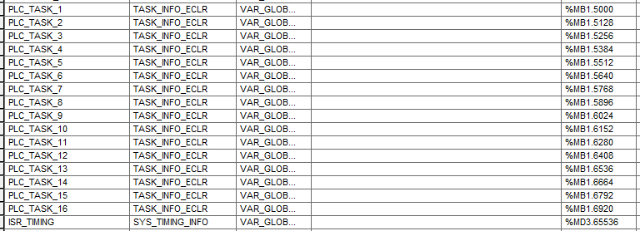
Task Timing Monitoring Variables
ECLR Controllers: MP2600iec and MP3xxxiec
Structures for real time task timing information available in the global variable table in MotionWorksIEC 2.5
Variable name
DATA TYPE
ADDRESS
Task timing in us
DPRAM / MECHATROLINK III Timing in us

Slide 18
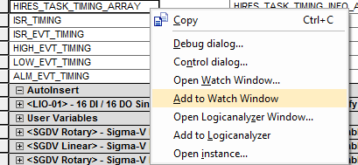
Add to Watch Window/Logic Analyzer
Task Timing Monitoring Variables
Select the relevant structures

Slide 19
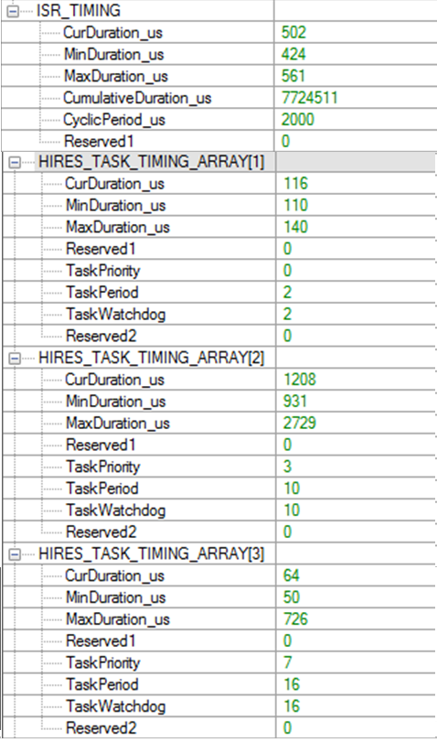
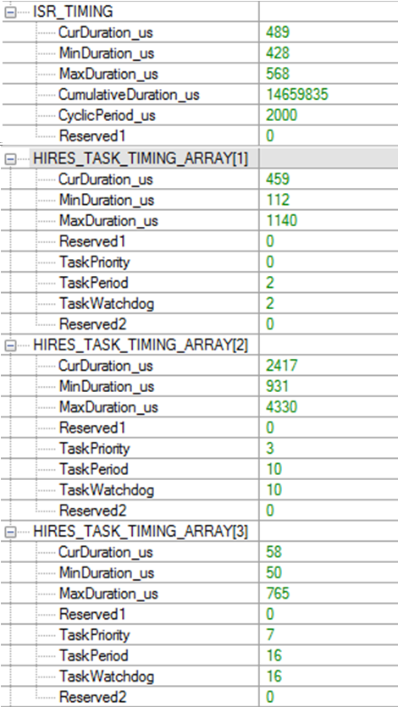
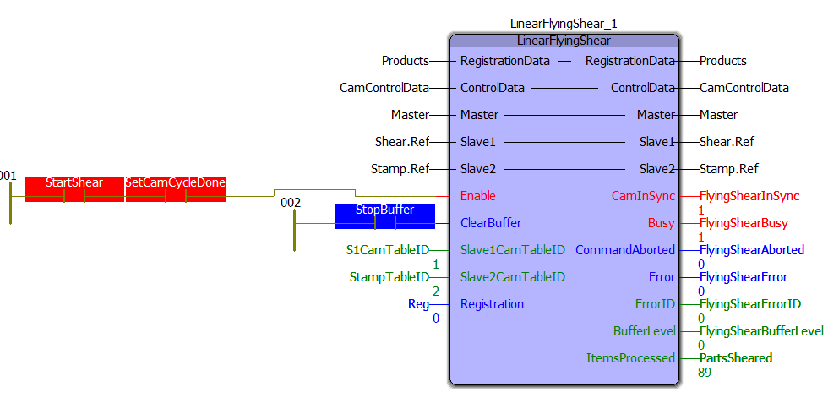
Explanation of Task Timing Variables
Task Timing at Standstill
Task Timing with Motion
Motion

Slide 20
Explanation of Task Timing Variables
2729 us
726 us
1140 us
4330 us
Timing info before motion commanded
Motion Command
Medium task interrupted
Medium task interrupted
Slow task interrupted

Slide 21
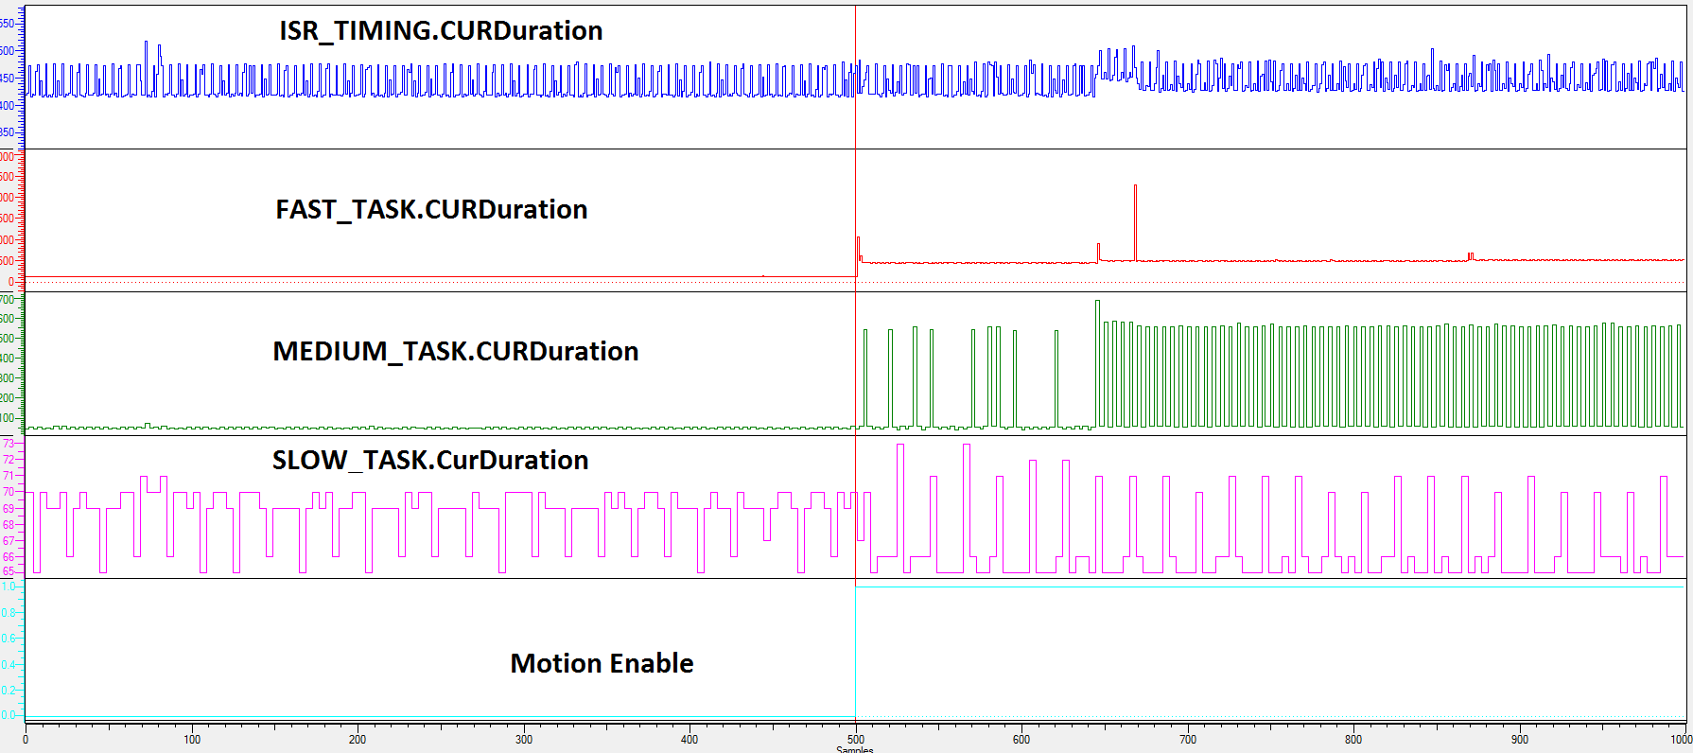
Explanation of Task Timing Variables
CamShift
Y_CamIn.Execute

Slide 22
Applying PLCopen rules to your application code
Interlocking Logic for Execute type function blocks
ErrorID should permeate up to the User Interface

Slide 23
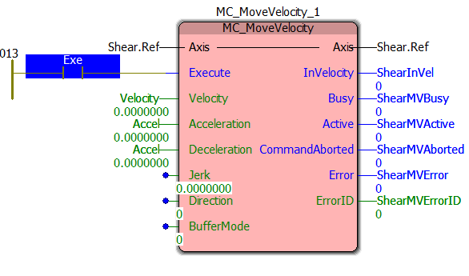
In our hurry to get programming done faster so that motion can be tested sooner, we ignore rules governing PLCopen blocks
Interlocking Logic for Exe Type Blocks
User Input from HMI
Exe
ShearMVError
6 ms

Slide 24
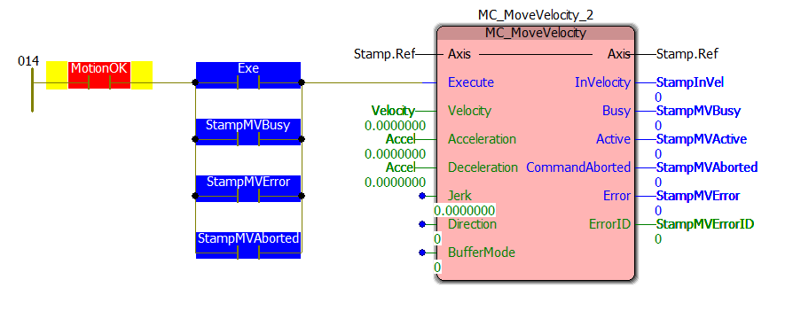
Model for logic that can convey function block status effectively
Interlocking Logic for Exe Type Blocks
Permissive bit *
Initiator bit
Latch when FB is
functioning properly
Latches when FB is in
error or is aborted
The ‘Permissive’ bit can be a status that allows the FB to run. It could be a user controlled
bit for user acknowledgement of FB status. It stands for all conditions that must be met for the block to run

Slide 25
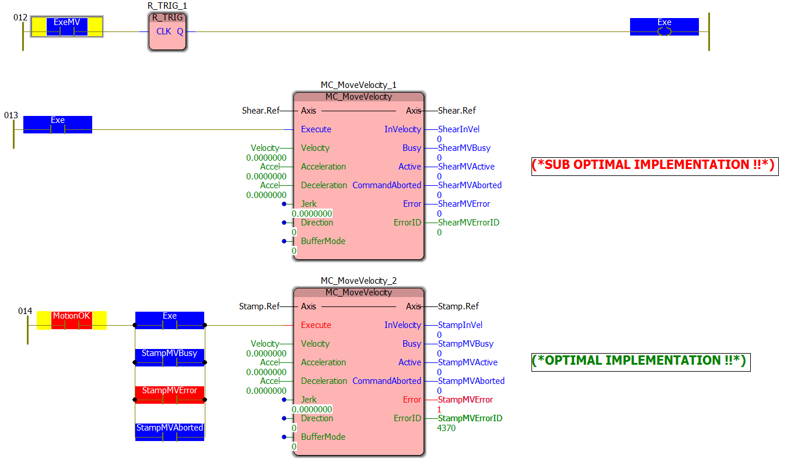
Live Demo
Interlocking Logic for Exe Type Blocks

Slide 26
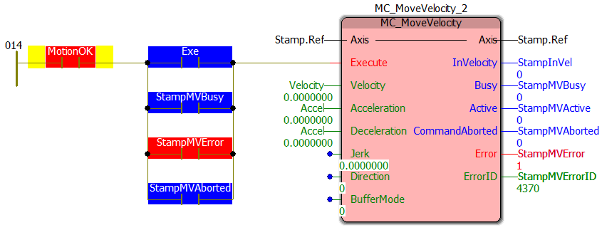
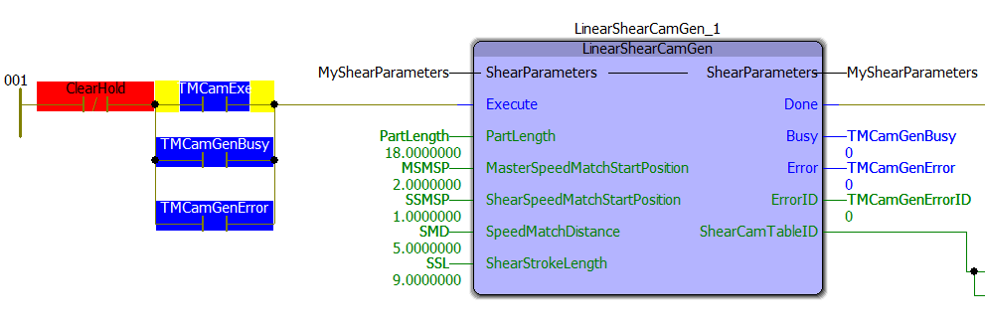
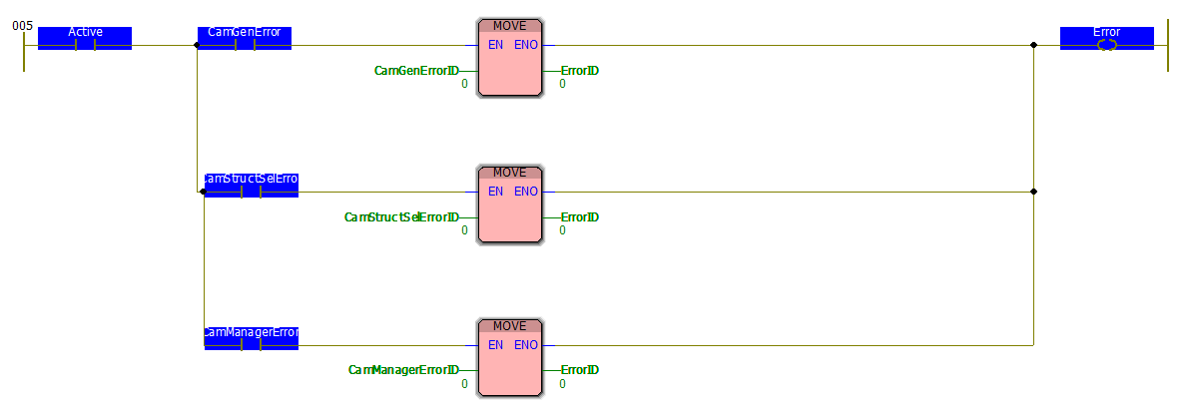
Function Block Status Flow
Execute
Done/Busy/Error/ErrorID
Application Code
User Library function block
Firmware Library function block

Slide 27
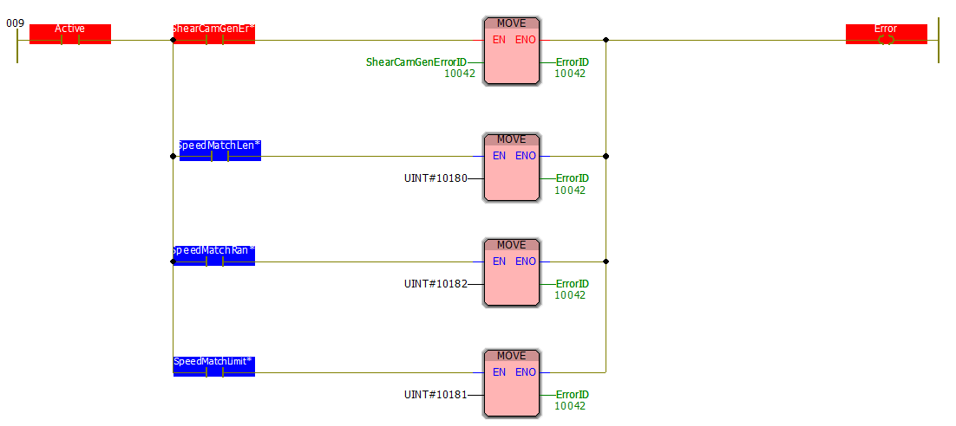
Function Block Status Flow
1) Keeping the Error ID latched on
VAR_OUTPUT
2) Passing the ErrorID upstream
to the application code

Slide 28
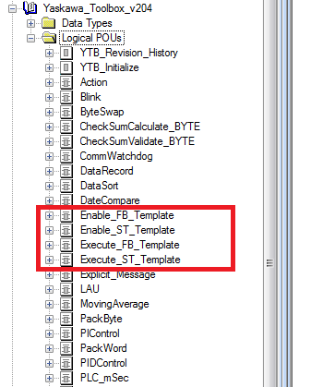
Refer to the Yaskawa Toolbox for templates
Function Block Status Flow
www.yaskawa.com/iectb

Slide 29
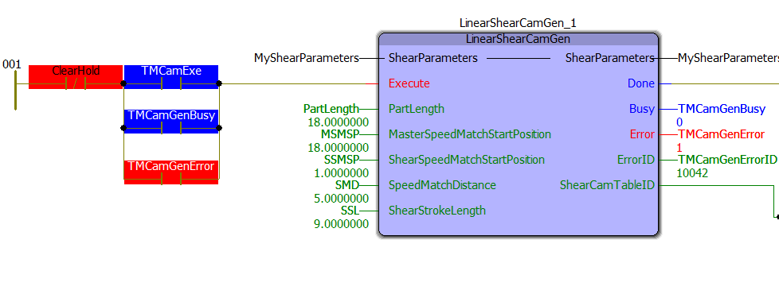
Function Block Status Flow
Application Code
User Library function block

Slide 30
Thank You!
PP.MPIEC.01 | Rev 1.00 | Date: 03/31/2011 | ©2010 Yaskawa America, Inc. All rights reserved.
Notes:
Name:
Company:
Address:
Phone:

