Slide 1
Product Launch
Food Grade and Hygienic Stainless Motors
Speaker Scott Carlberg | Date August 29, 2022

Slide 2
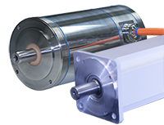
Topics for Discussion
Overview of Food Grade & Hygienic Motors
Sigma-7 SERVOPACKs and Cabling
Sales Tools
Stock & Delivery

Slide 3
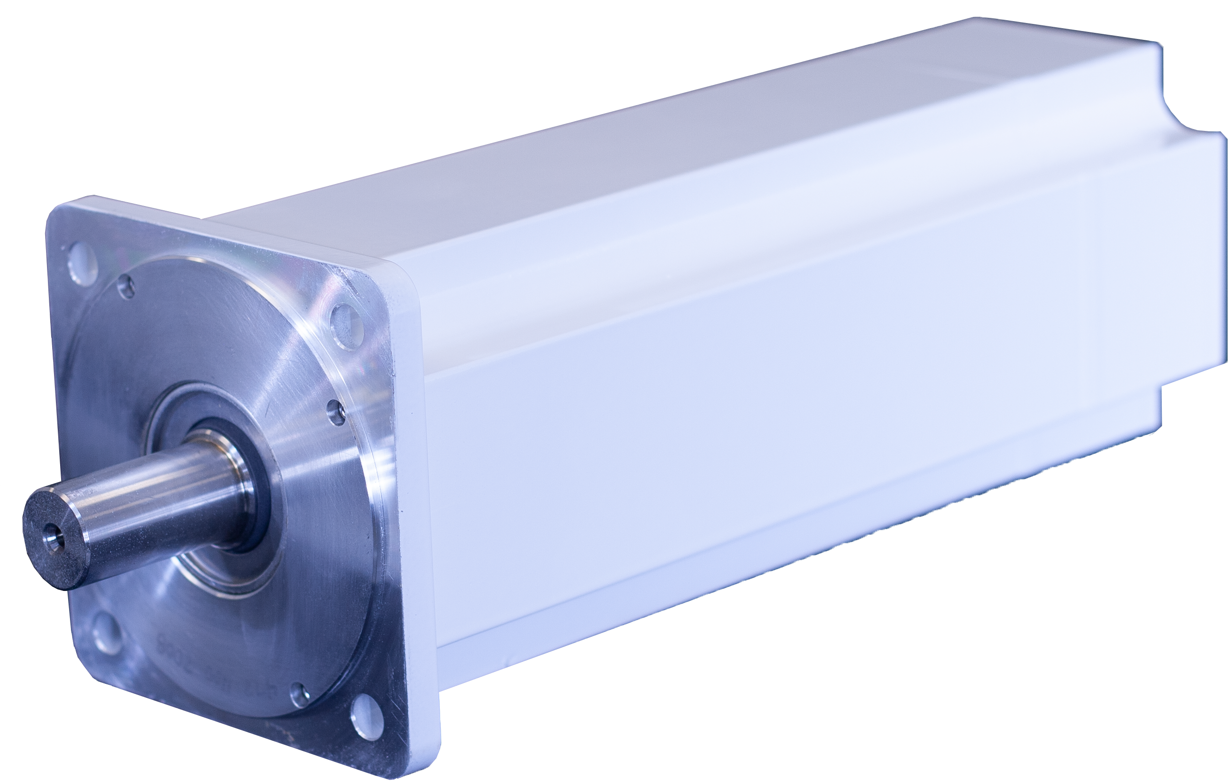
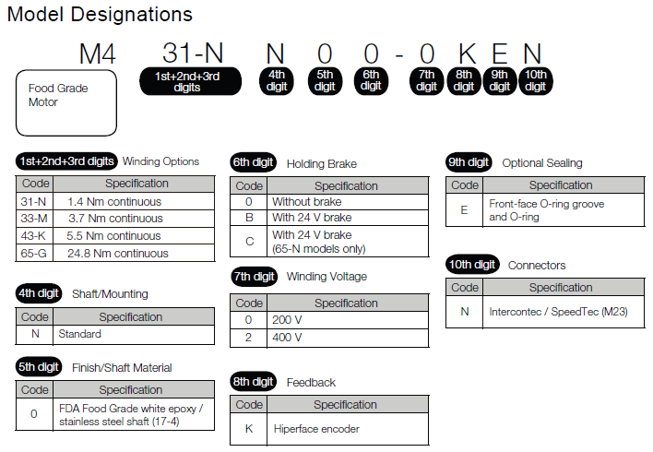
Food Grade Motors
FDA approved white epoxy coating
Finless extruded aluminum housing
IP66 sealing (high pressure wash down)
UL (cRUus), CE, RoHS
Stainless steel shaft, Teflon seal
Four frame sizes
200V & 400V windings
24V brake option
Hiperface absolute encoder
Designed specifically for food and baking industries

Slide 4
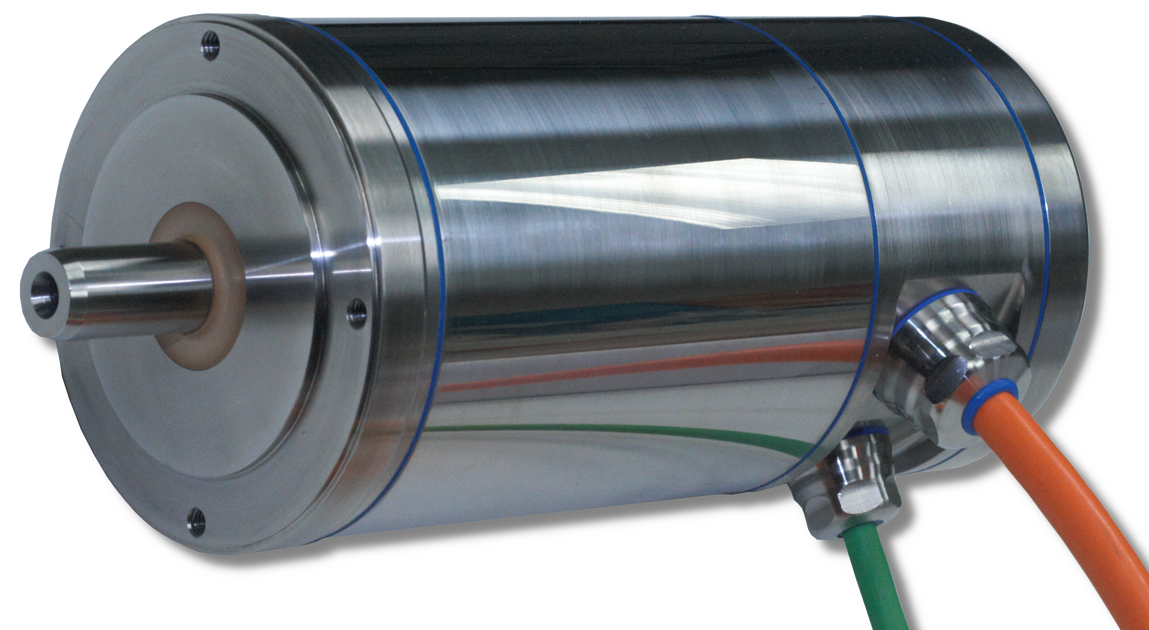
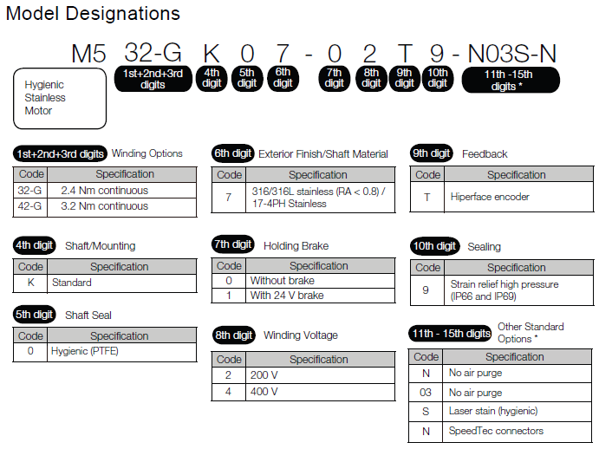
Hygienic Stainless Motors
All stainless design for maximum corrosion resistance
Smooth finish – no sharp corners
IP66 and IP69/IP69k sealing
EHEDG, UL (cRUus), CE, RoHS
Two frame sizes
200V & 400V windings
24V brake option
Hiperface absolute encoder
Ideal for food and beverage processing equipment

Slide 5
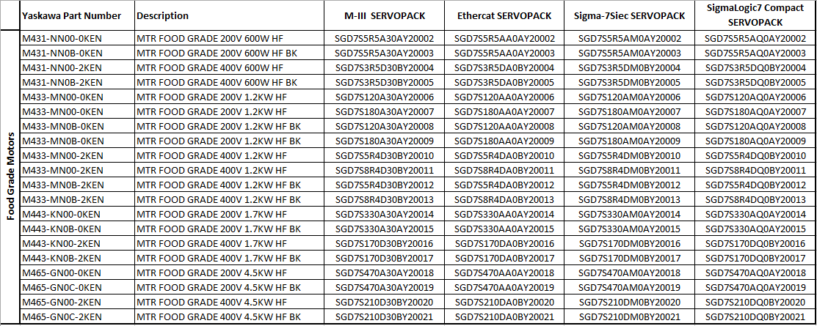
Sigma-7 SERVOPACKs

Slide 6
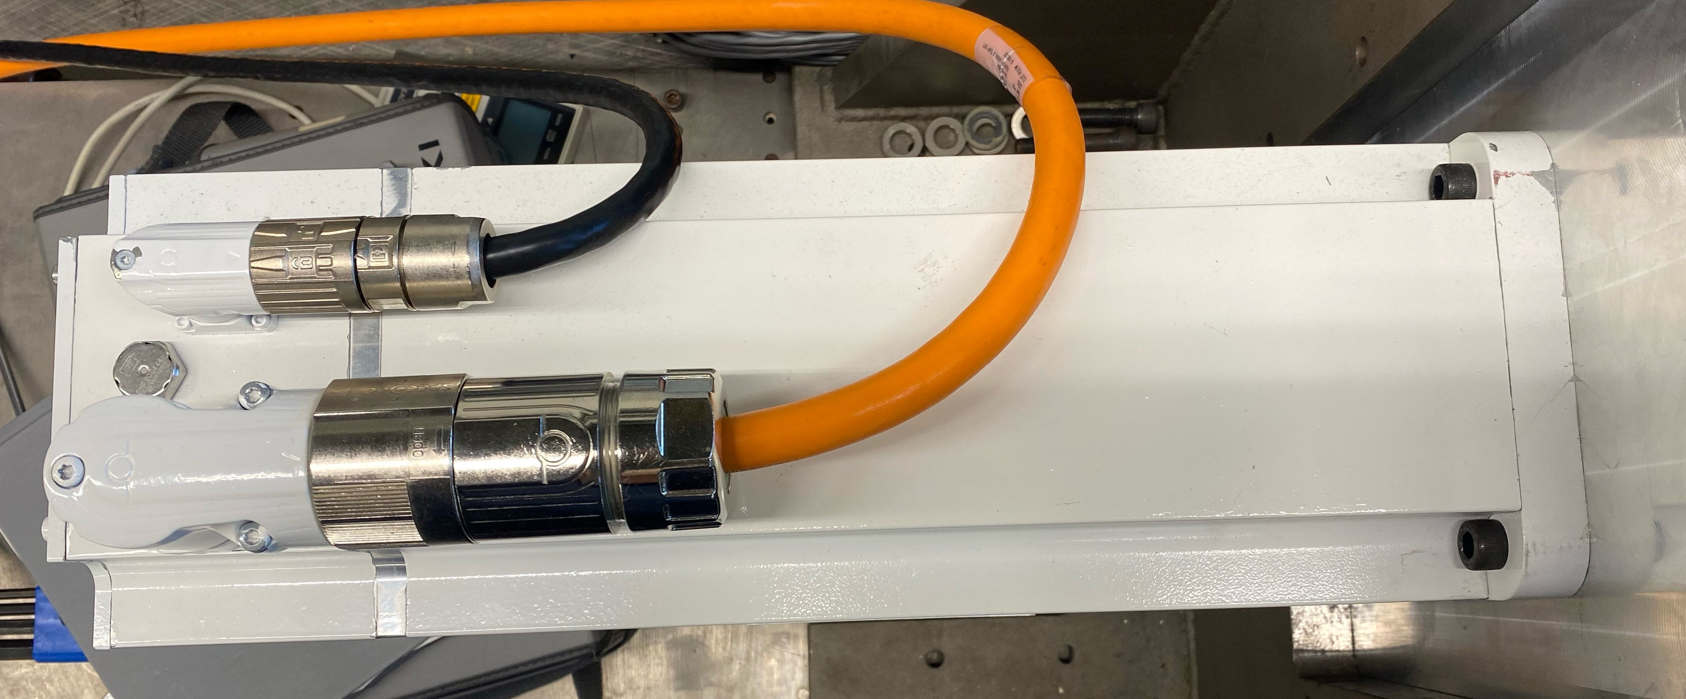
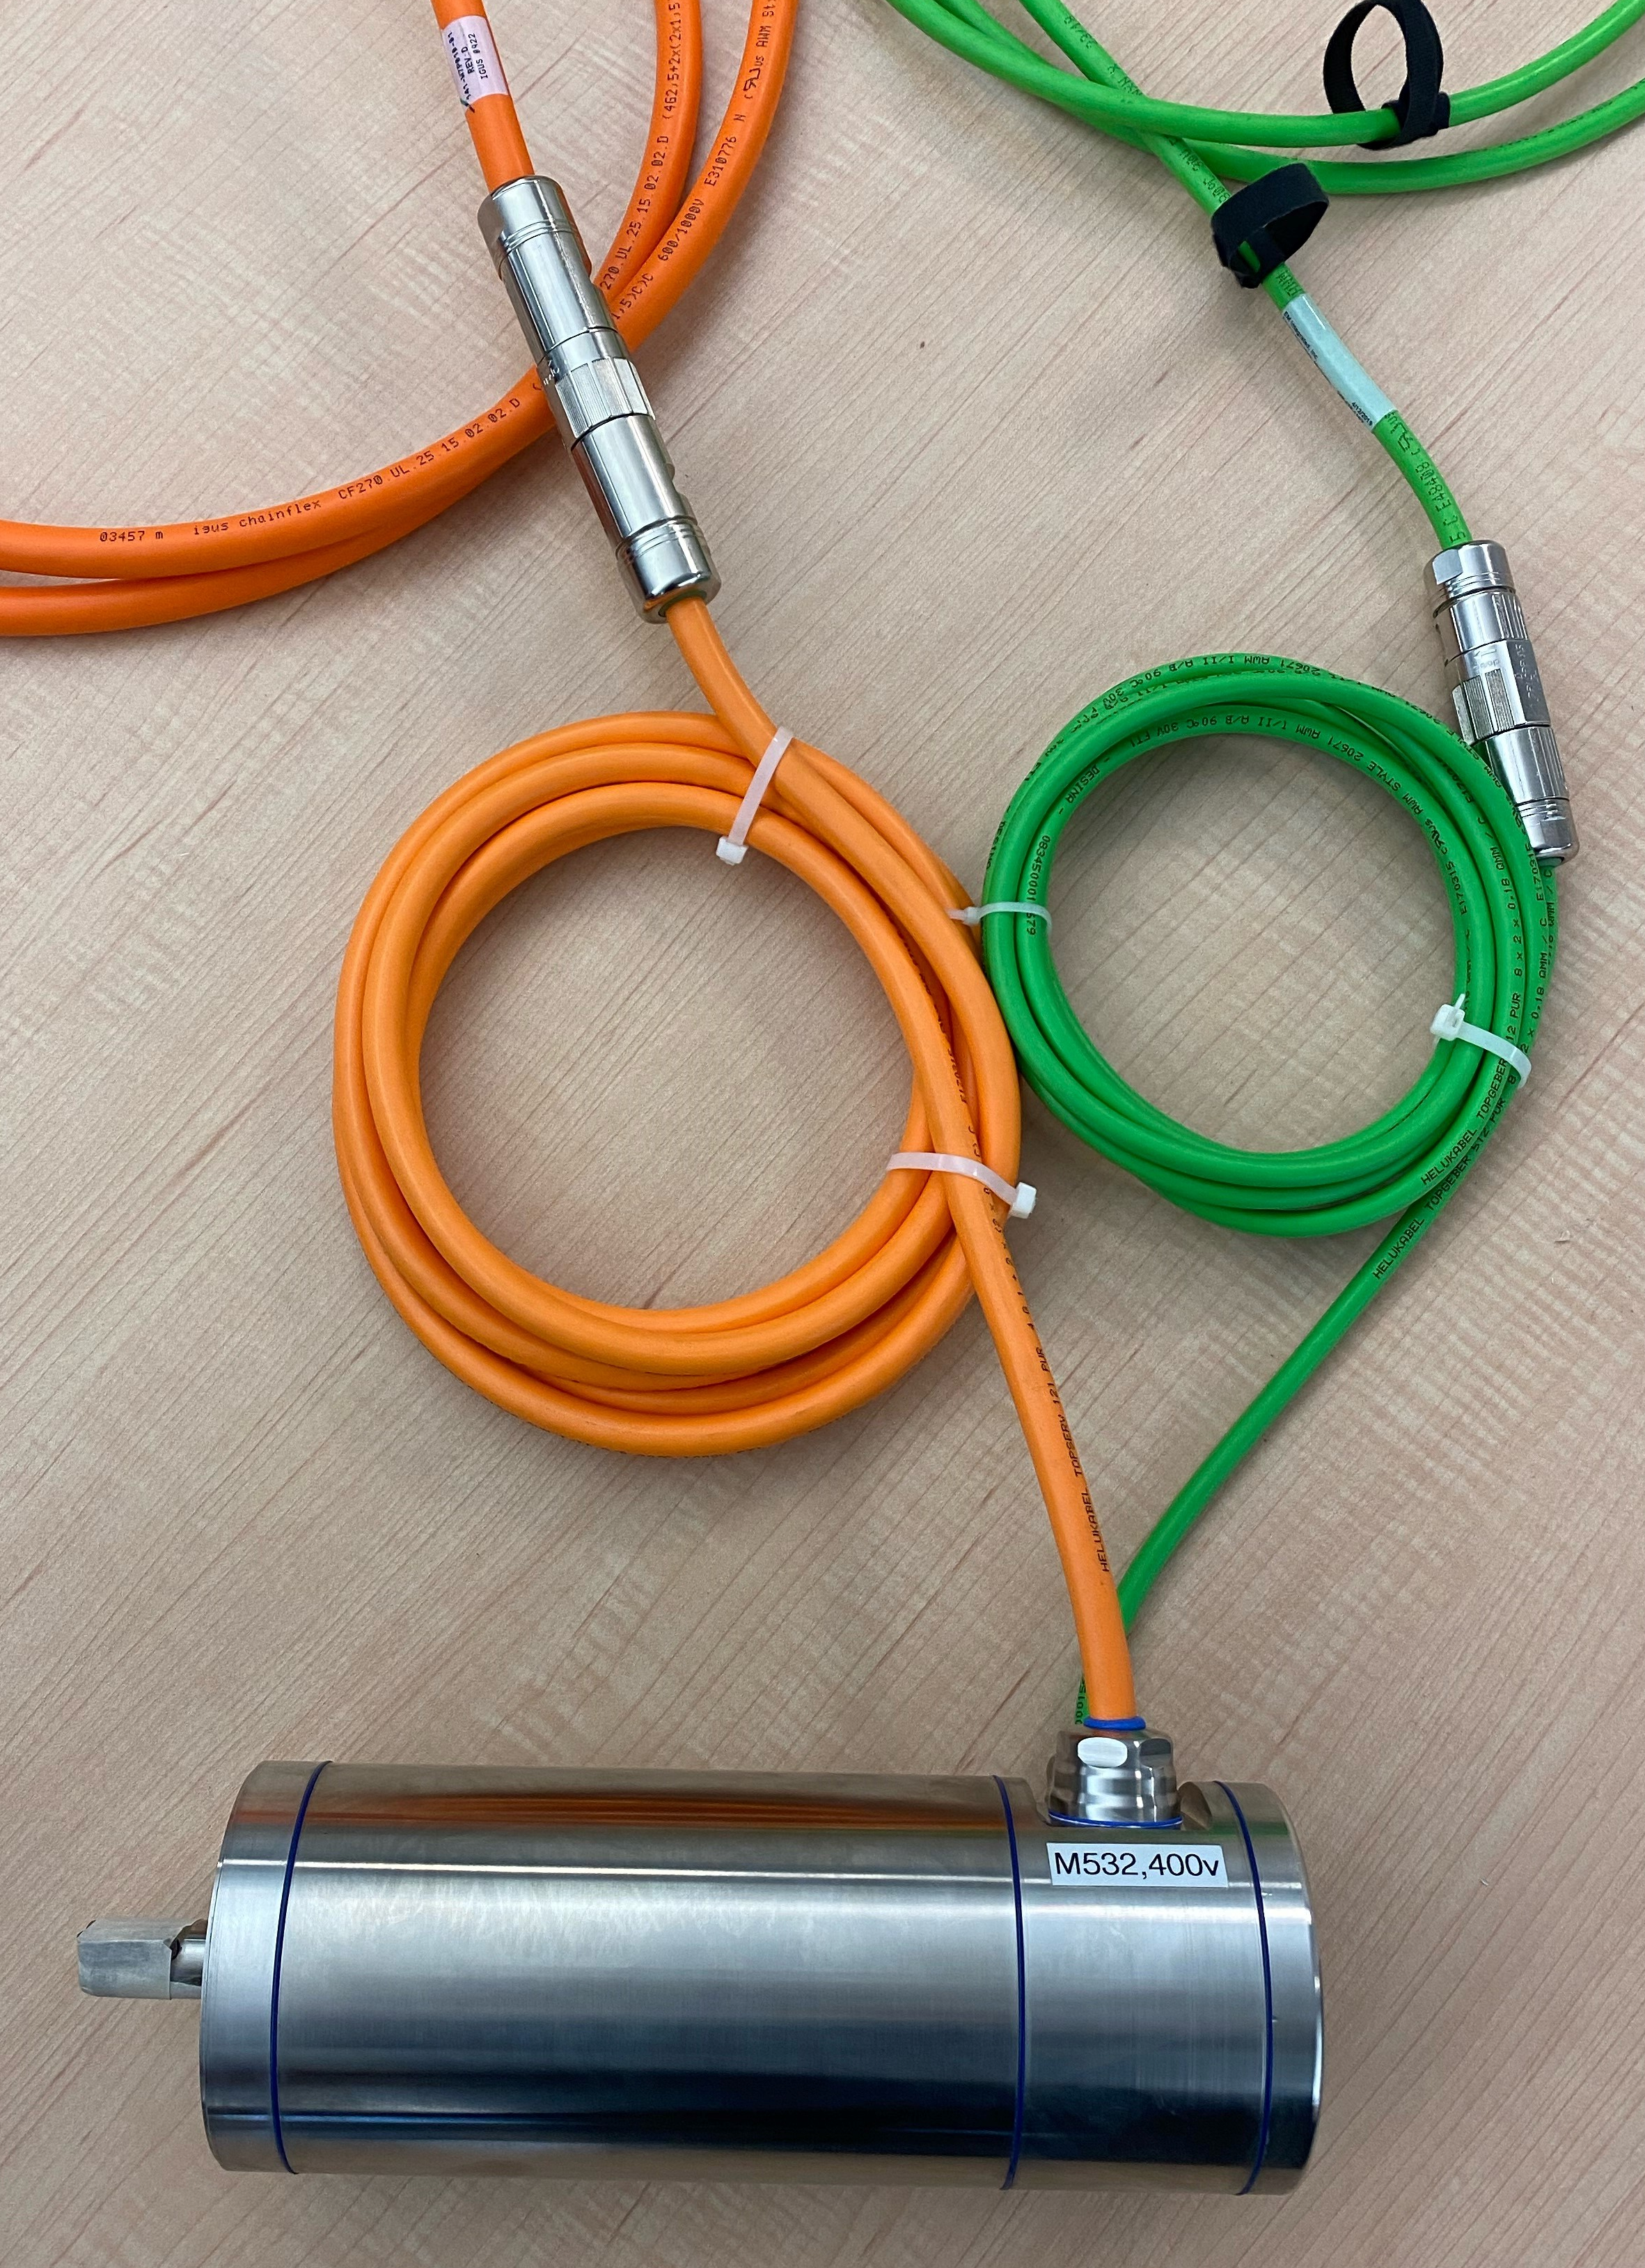
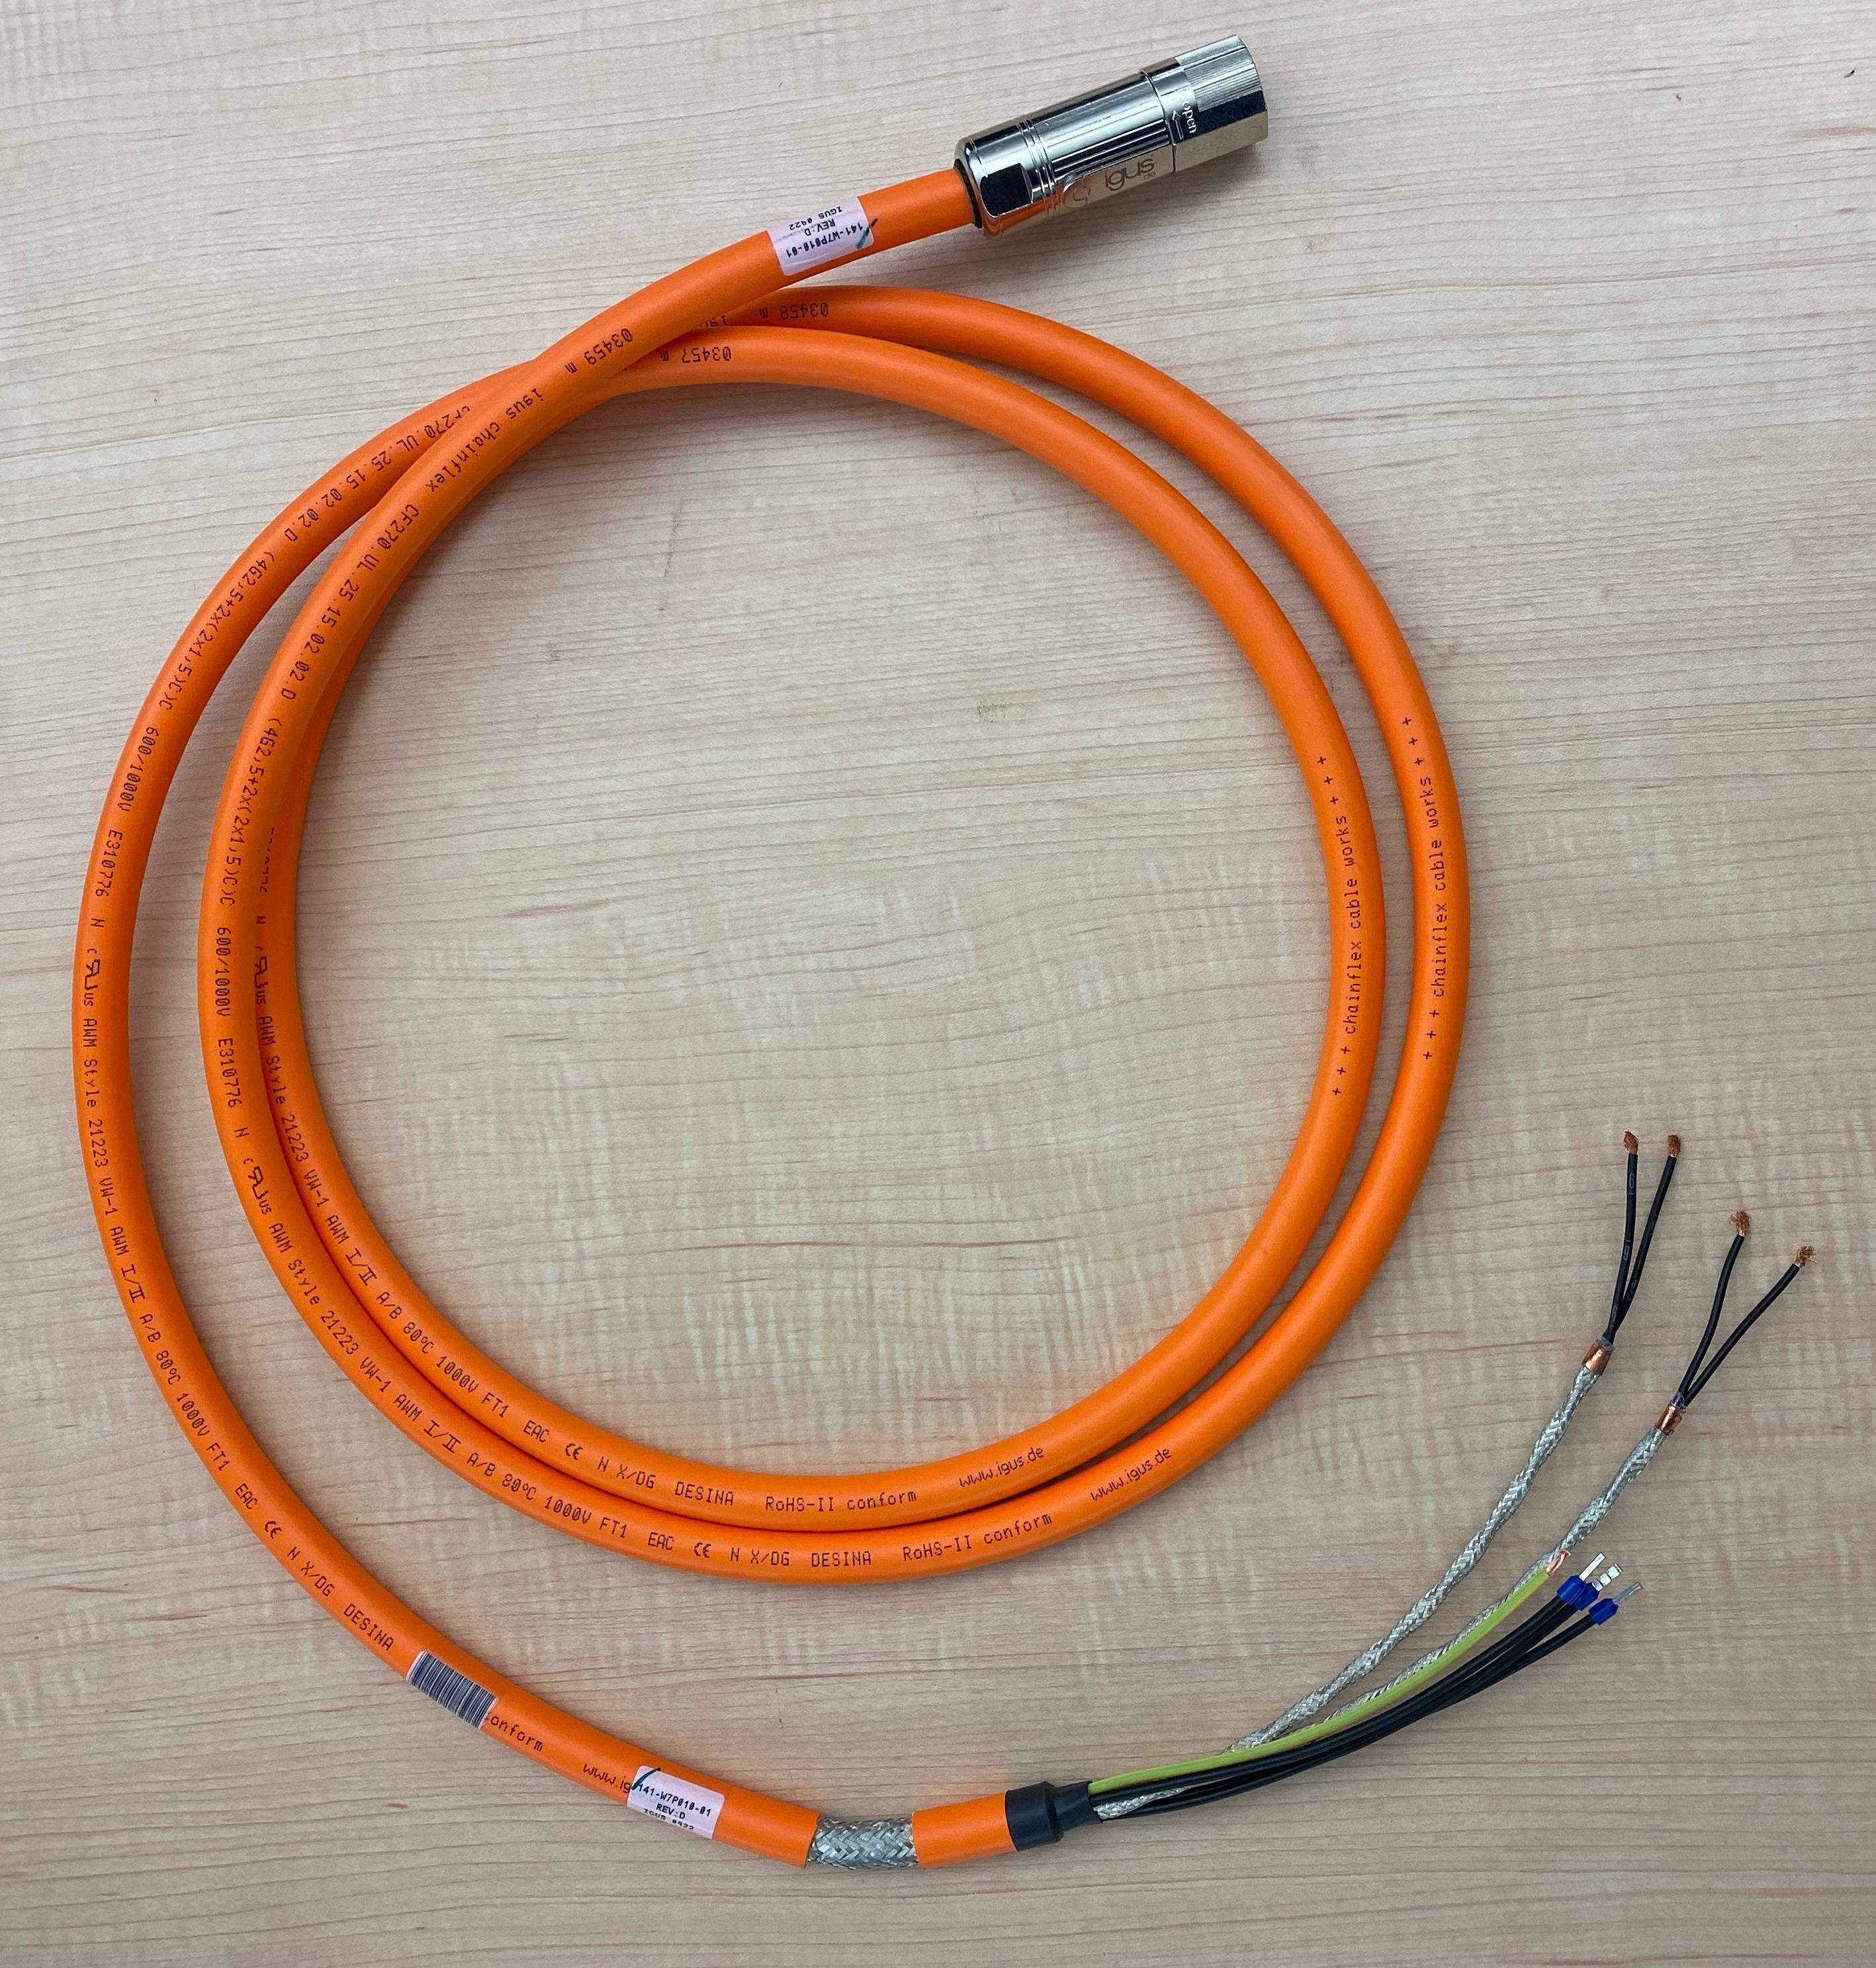
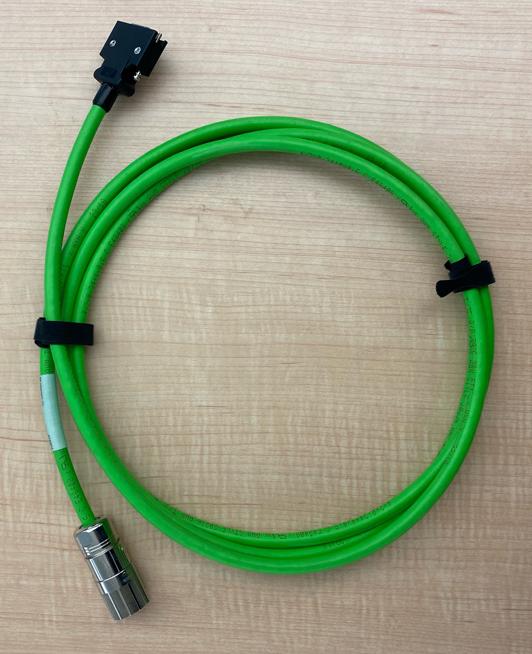
Cabling
3-20m
Shielded
IP66
Power Cable
Encoder Cable

Slide 7
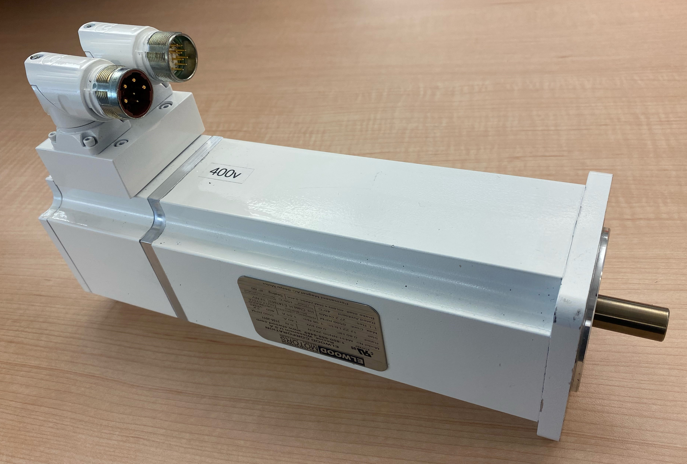
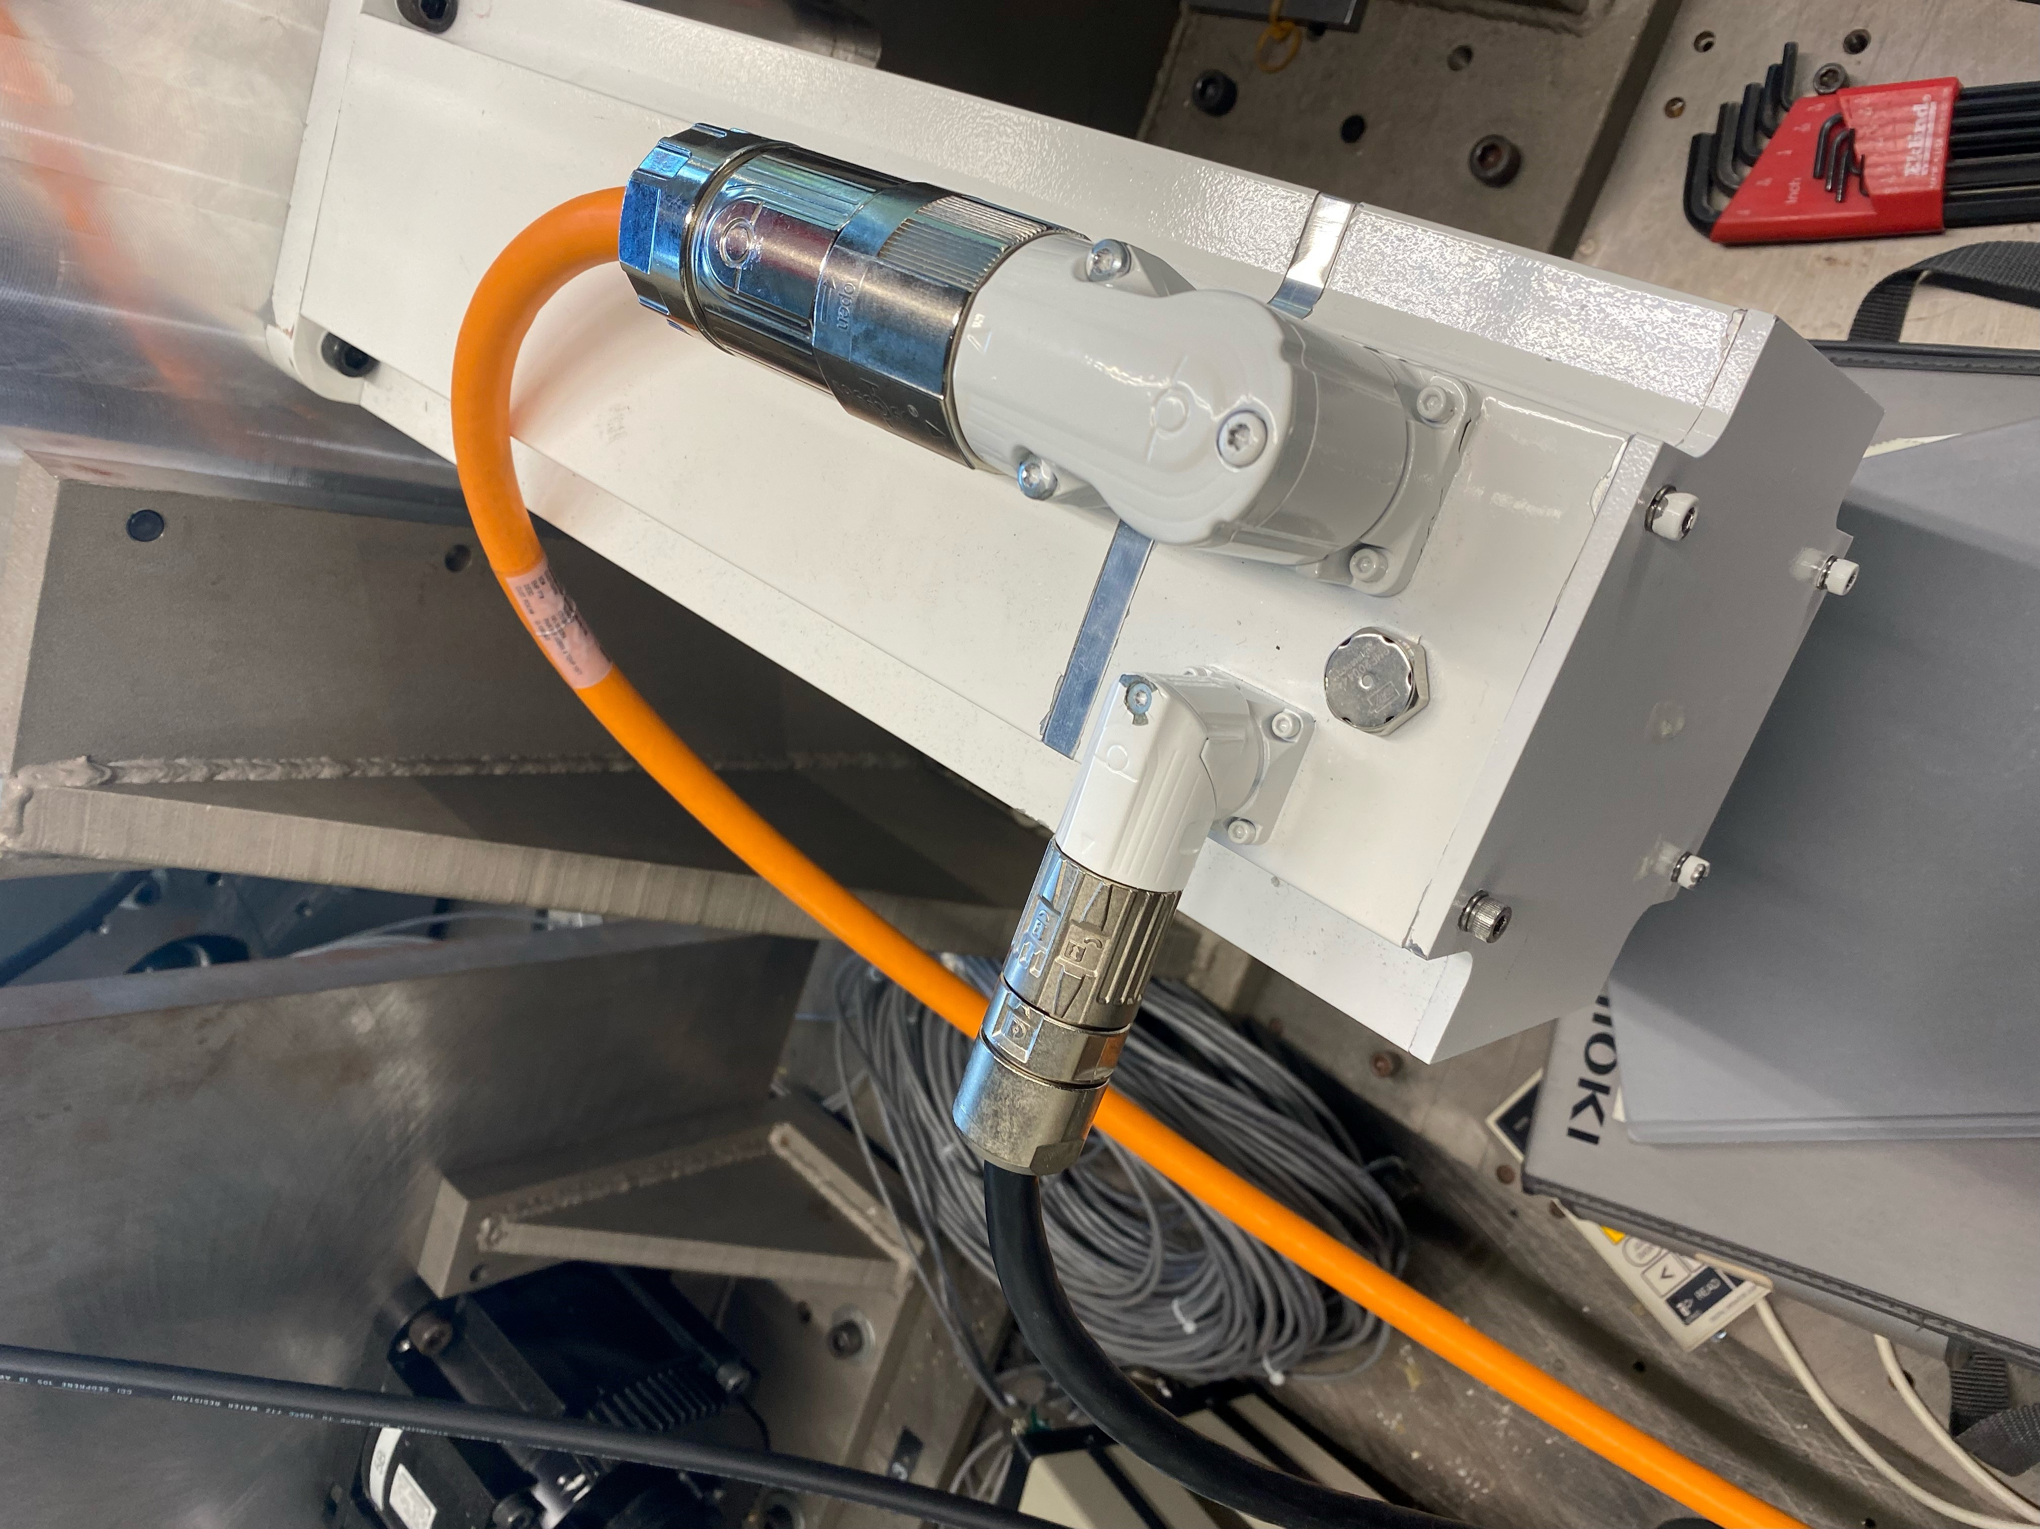
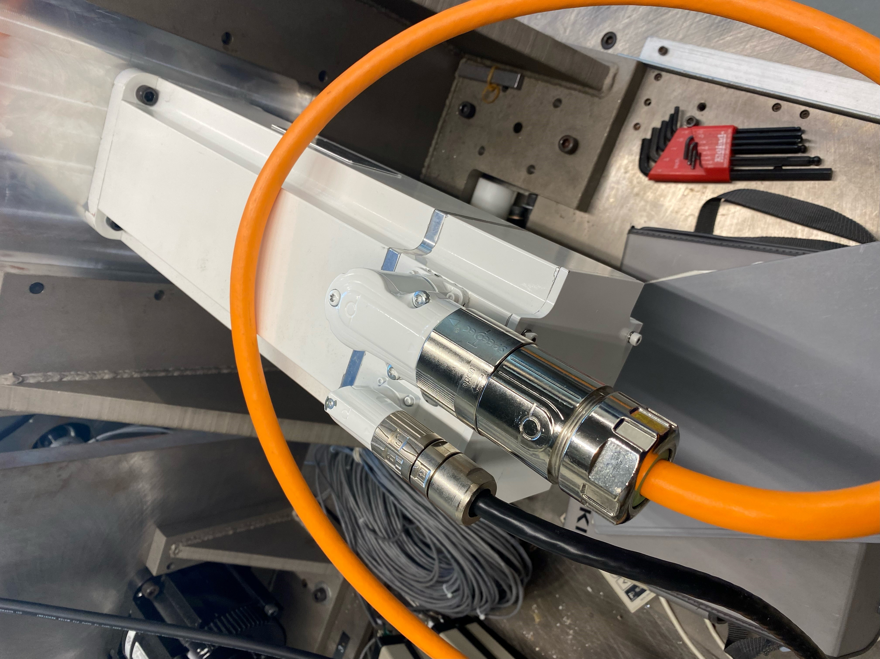
Motor Details
Elwood Nameplates
Rotatable connectors
Elwood Namplate
Rotating Connectors

Slide 8
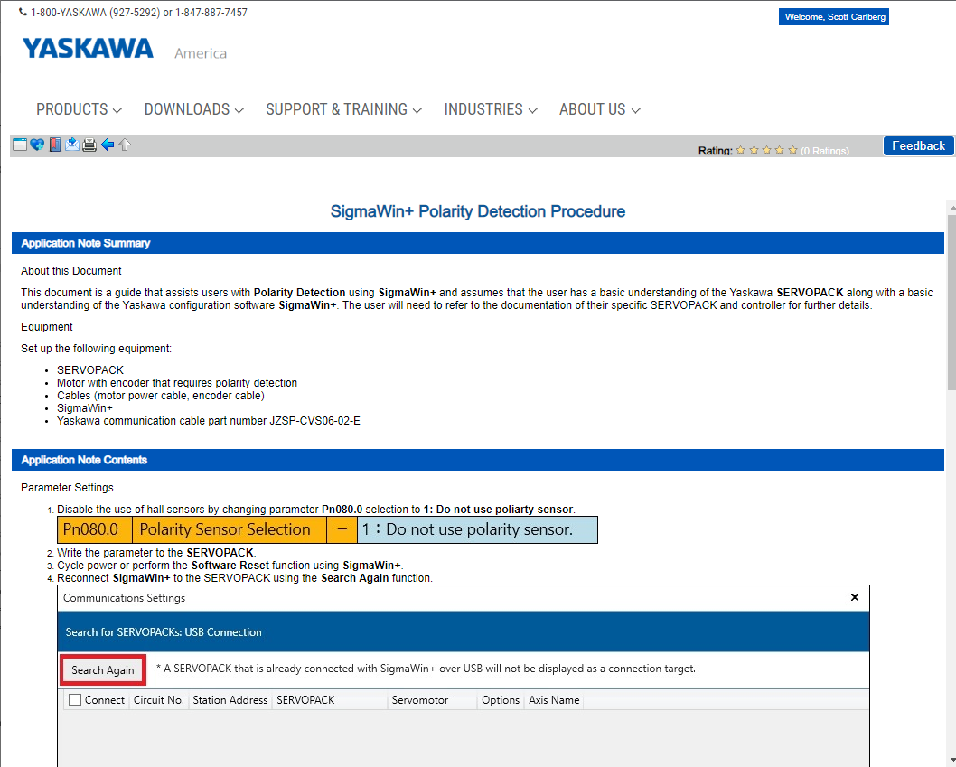
Application
Polarity Detection Procedure
Yaskawa Solution Center
Temporary Requirement
eLearning Module
Application Note

Slide 9
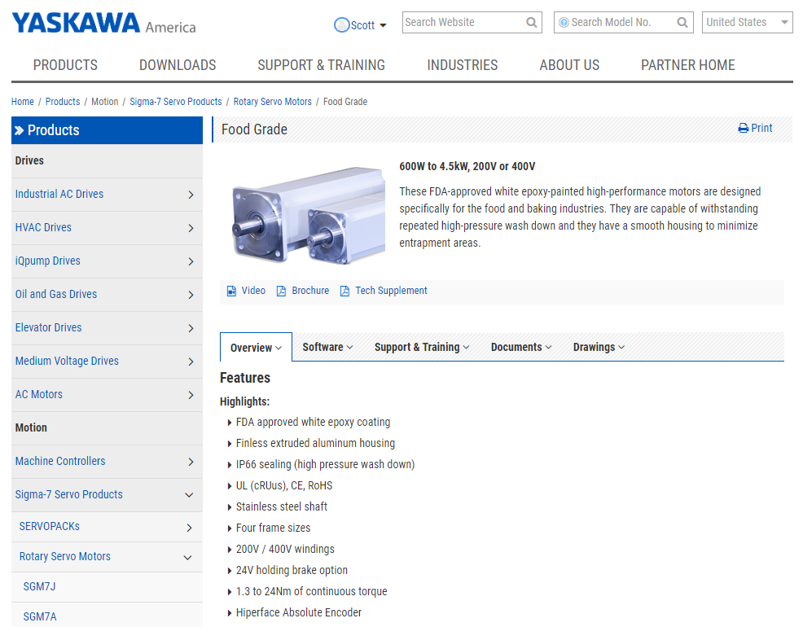
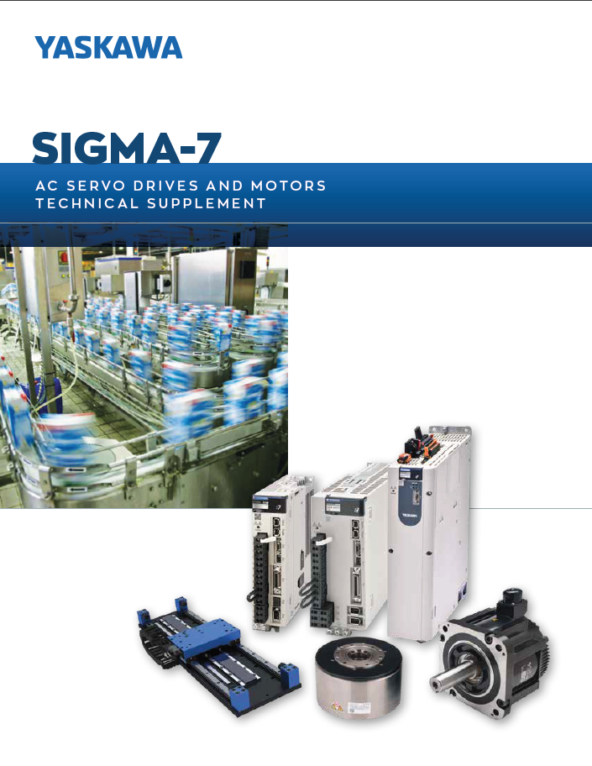
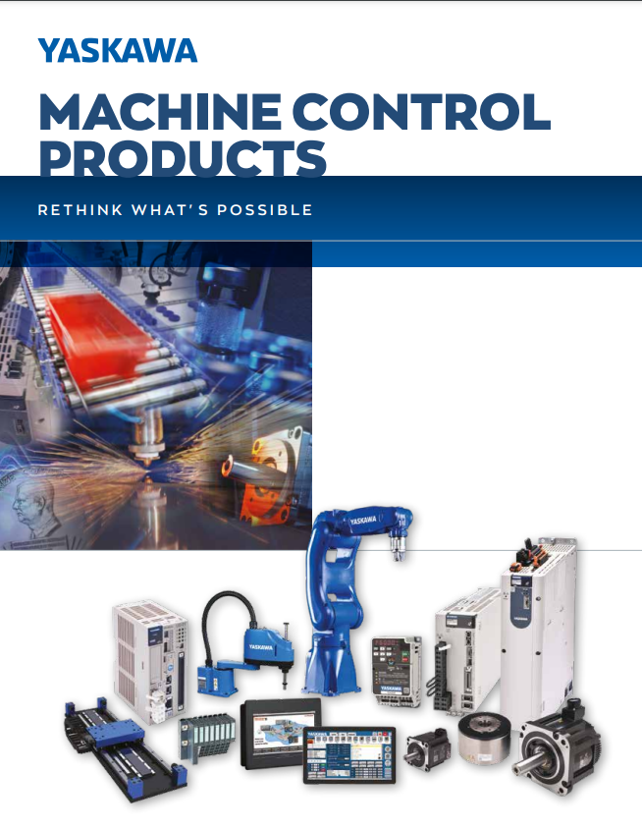
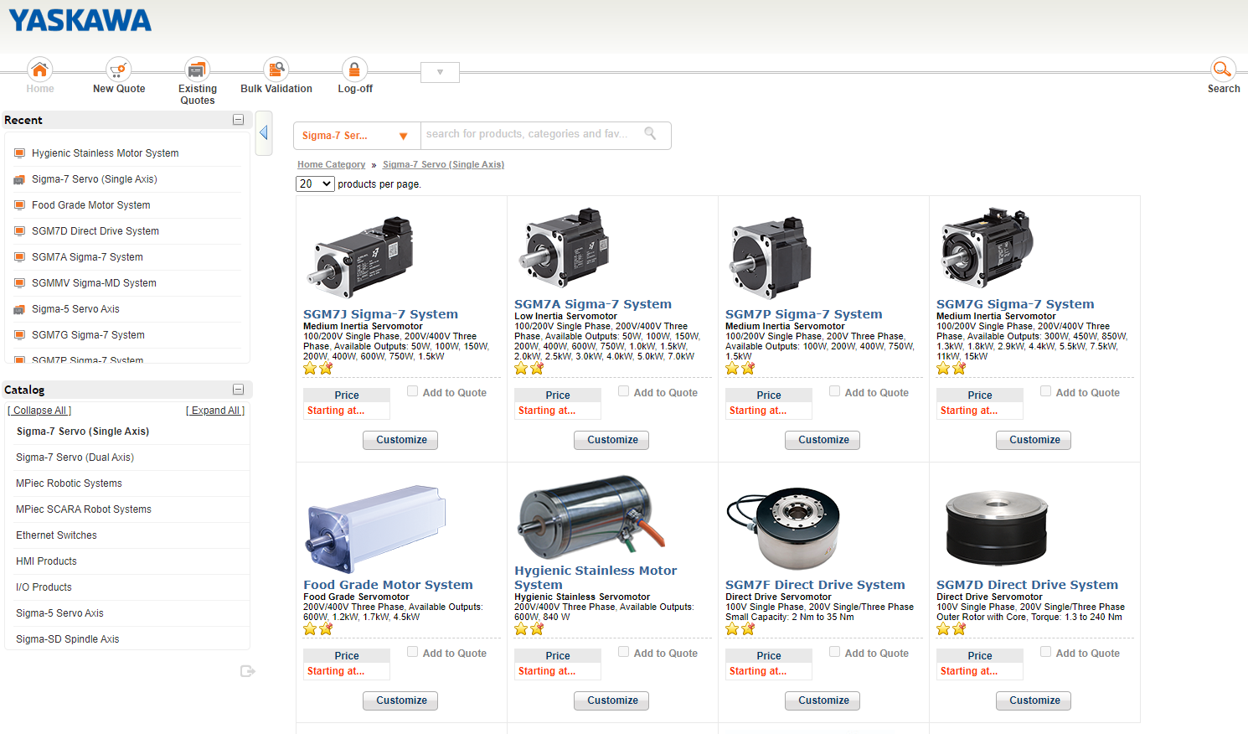
Sales Tools
Website
Sigma-7 Technical Supplement
Motion Brochure
OPT

Slide 10
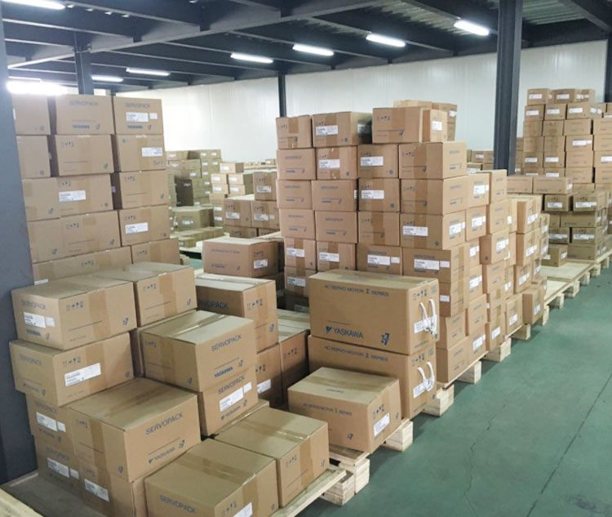
Stock and Delivery
Current Stock = $300k (65 motors)
Lead Time from Elwood = 6-8 weeks
Please provide Yaskawa with forecasting information so we can stock product accordingly!

Slide 11
Questions

